Slide 1
Group Testing – a tool of protecting Network Security
Hung-Lin Fu 傅 恆 霖
Department of Applied Mathematics, National Chiao Tung University, Hsin Chu, Taiwan

Slide 2
Group testing (General Model)
Consider a set N of n items consisting of at most d positive (used to be called defective) items with the others being negative (used to be called good) items.
A group test, sometimes called a pool, can be applied to an arbitrary set S of items with two possible outcomes; negative: all items in S are negative; positive: at least one positive item in S, not knowing which one or how many.

Slide 3
Adaptive (Sequential) and Non-adaptive(Parallel) Algorithms
Adaptive Algorithm: You ask the second question (query) after knowing the answer of the first one and continue …. That is, the previous knowledge will be used later.
Non-adaptive Algorithm: All the queries are designed beforehand and then you ask all the questions (queries) simultaneously.

Slide 4
Algorithms
Adaptive algorithm
Non-adaptive algorithm
k-stage algorithm
The most popular one is a 2-stage algorithm in which we use a non-adaptive algorithm first and then in the second stage we test the left “suspected” items one by one.

Slide 5
Save Money or Time
An adaptive (sequential) algorithm conducts the tests one by one and the outcomes of all previous tests can be used to set up the later test. (Save money!?)
A non-adaptive algorithm specifies a set of tests in advance so that they can be conducted simultaneously; thus forbidding using the information of previous tests. (Save time!)
In general, an adaptive algorithm takes less queries (compare to a non-adaptive algorithm) to get the job done.

Slide 6
Adaptive Algorithm
By the nature of this algorithm, we normally find all the positives by way of a search algorithm step by step.
The most popular one is the splitting algorithm which takes around log₂n steps to locate a positive items out of n items.
In fact, this answer is best possible for one positive item by using the information lower bound.

Slide 7
Non-adaptive Algorithm
A non-adaptive algorithm can be represented by a (0,1) – matrix M = [m_{i,j}] such that columns are items, rows are tests and m_{i,j} = 1 if and only if the j^{th} item is “involved” in the i^{th} test.
The matrix represents a non-adaptive algorithm is also known as a “pooling design”.

Slide 8
An example (12 items and 9 tests)
1 |  |  | 1 |  |  | 1 |  |  | 1
1 |  |  |  | 1 |  |  | 1 |  |  | 1
1 |  |  |  |  | 1 |  |  | 1 |  |  | 1
 | 1 |  | 1 |  |  |  |  | 1 |  | 1
 | 1 |  |  | 1 |  | 1 |  |  |  |  | 1
 | 1 |  |  |  | 1 |  | 1 |  | 1
 |  | 1 | 1 |  |  |  | 1 |  |  |  | 1
 |  | 1 |  | 1 |  |  |  | 1 | 1
 |  | 1 |  |  | 1 | 1 |  |  |  | 1
The blanks
are zeros.

Slide 9
Set Notations
Let M = [m_{i,j}] be a txn matrix mentioned above. Then we can use n sets (ordered) S_{i}’s to represent the matrix where
S_{k} = {i : m_{i,k} = 1, i = 1, 2, …, t}, k = 1, 2, …, n.
The following sets represent the above (0,1)-matrix:
{1,2,3}, {4,5,6}, {7,8,9}, {1,4,7}, {2,5,8}, {3,6,9}, {1,5,9}, {2,6,7}, {3,4,8}, {1,6,8}, {2,4,9}, {3,5,7}.

Slide 10
Relation with Designs and Codes
It is easier to apply combinatorial structures to construct pooling designs, therefore, we use sets (or codewords) for columns in non-adaptive algorithms.
The set corresponding to a codeword (binary vector) is called the support of the codeword.

Slide 11
Various Models
There are inhibitors.
There is a threshold.
Defective items are sets: complex model.
Competitive model: the number of defectives is unknown.
The defectives are mutually obscuring.
Size constraint group testing.

Slide 12
Further Remarks
We can approach this study via different topics such as combinatorial design, algebraic combinatorics, coding theory and graph theory.
Group testing does play an important role in applications such as computational molecular biology, network security, image compression, …, etc.

Slide 13
Compressed Sensing
In compressed sensing (CS), we are given an n-dimensional sparse signal with support size K.
Random (?) projections of the sparse signal are obtained. (We notice the projection if it is not orthogonal to the signal, i.e. the inner product of the two vectors is not equal to zero.)
The goal is to identify the support set while minimizing the number of projections.

Slide 14
Outcome Vectors
The vector y is an outcome vector which is corresponding to an input x.
If M is 1-1, then we can decode x as long as we know its outcome vector.
In order to get the job done with lower decoding complexity, extra properties for m is needed. (This is the combinatorial part!)

Slide 15
Signal: 010000010000
Outcome vector: 010111100
1 |  |  | 1 |  |  | 1 |  |  | 1
1 |  |  |  | 1 |  |  | 1 |  |  | 1
1 |  |  |  |  | 1 |  |  | 1 |  |  | 1
 | 1 |  | 1 |  |  |  |  | 1 |  | 1
 | 1 |  |  | 1 |  | 1 |  |  |  |  | 1
 | 1 |  |  |  | 1 |  | 1 |  | 1
 |  | 1 | 1 |  |  |  | 1 |  |  |  | 1
 |  | 1 |  | 1 |  |  |  | 1 | 1
 |  | 1 |  |  | 1 | 1 |  |  |  | 1
The blanks
are zeros.

Slide 16
Network Security
This is a topic which is too wide and large to be well studied.
We can only pick up certain parts of network to see if we can do something about them.
I am a combinatorial people and I know not much about network.
We started to notice that group testing can play an important role on network security not long time ago, I am learning!

Slide 17
An Application of Size Constraint GT
A size constraint GT is a pooling design such that both of the number of rows and the number of 1’s in each row are bounded by fixed constants respectively. For example, a pooling design has at most K rows and each row is of weight at most w.
This design is working for Denial-of-Service (DoS) attack.

Slide 18
DoS Attack
The Denial-of-Service (DoS) attack is aiming at disrupting application service rather than depleting the network resource.
Owing to its high similarity to legitimate traffic and much lower launching overhead than classic DoS attack, this new assault type cannot be efficiently detected or prevented by existing detection solutions.

Slide 19
Continued
The key problem to identifying attackers lies in how to group clients together on each server so that if a server is under attack, we can quickly identify these attackers without examining each request.
Since the number of available pools (virtual servers) and the number of clients/requests in a pool (server) has its limitation, an SCGT is required.

Slide 20
The Challenges
(1) How to construct a pooling design to enable prompt and accurate detection.
(2) How to regulate the service requests to match the design in a practical system.
(3) How to establish proper thresholds for server source usage indicator to generate accurate test outcomes.

Slide 21
Interference Free GT and Reactive Jamming Attacks
Reactive Jamming attack has a great security threat to wireless sensor networks (WSN).
There exist many studies against these attacks, however, these methods such as frequency hopping or channel surfing, require excessive computational capabilities on wireless devices.

Slide 22
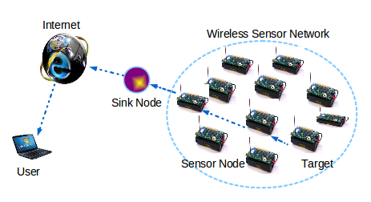
Wireless Sensor Network

Slide 23
Key Idea
We can apply an interference free group testing to identify the trigger nodes, whose transmissions activate any reactive jammers.
The identification of these trigger nodes can help us to (1) design a better routing protocol by switching these nodes into only receivers to avoid activating jammers and (2) locate the jammers based on the trigger nodes, thus providing a mechanism against reactive jamming attacks.

Slide 24
Group Testing Works Here
There are three types of nodes: (1) Victim nodes (VN): if a node v hears a jamming signal, then v is VN; (2) Unaffected nodes (UN): nodes are not being jammed, i.e., cannot hear the jamming signals; and (3) Boundary nodes (BN): vis said a BN if v is a UN who has a neighbor node as a victim.
The purpose of BNs is to estimate the jamming range R where the VN set is to be tested to obtain the trigger nodes.

Slide 25
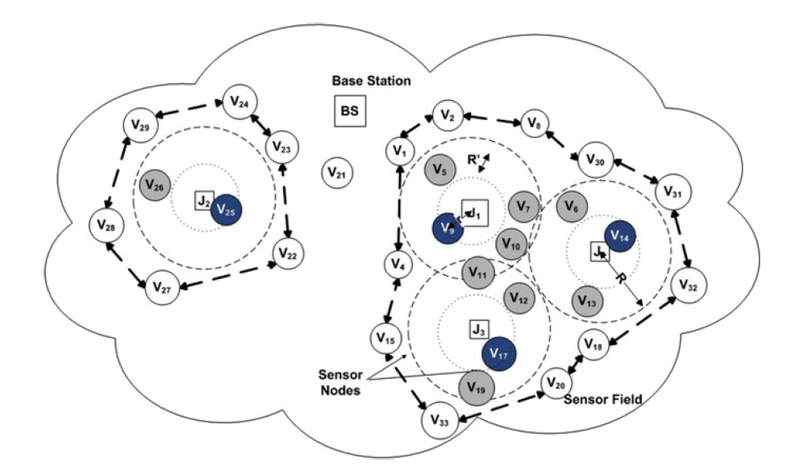
Wireless Sensor Network
Nodes in grey and blue are VNs around jammer nodes, where blue nodes are also trigger nodes, which invoke the jammer nodes. Nodes surrounding the jammed area are BNs, while the others are UNs.

Slide 26
For more details about the above two applications, please refer to the book “Group Testing Theory in Network Security” written by My T. Thai.

Slide 27
Multimedia Fingerprintings
To prevent attacks from unauthorized users we encrypt the copyrighted information.
To hinder attacks from authorized users we fingerprint the copyrighted information.
Normally, fingerprints are embedded (through watermarking techniques) into multimedia contents.
Information is represented by waveforms, which are viewed as vectors in signal space.

Slide 28
Fingerprinting Code: An Example
Copyrighted sequence: 0101010101010101010100011
Short sequences: 0001, 1010
Fingerprinted sequence:
0101110101010111010100011
Pirate sequences:
0101010101010101010100011
0101110100010111010100011

Slide 29

Copyrighted Information

Slide 30
Collusion Attacks
The averaging attack (average multiple copies of the authorized content together) is the most feasible approach to perform collusion attacks.
This attack reduces the power of each contributing fingerprint (fairness between colluders) and makes the colluded signal have perceptual quality.

Slide 31
Digital Fingerprinting Codes
We try to find efficient fingerprinting codes which is effective for colluder-tracing.
This is equivalent to require a good code which can be used by more users (large number of codewords) and also capable of tracing as many colluders as possible, moreover, the tracing algorithm had better with low complexity.

Slide 32
Apply Pooling Designs
The idea of tracing colluders is similar to finding positive items in group testing.
In group testing, in order to find d positive items, we use a d-disjunct matrix which has faster decoding algorithm or a d-separable matrix which has decoding algorithm with higher complexity.
These matrices are (0,1) − matrices.
How about [0, q-1] − matrices?
Find good anti-collusion codes!

Slide 33
References for Fingerprinting Codes
M. Cheng, H.-L. Fu, J. Jiang, Y.-H. Lo and Y. Miao, Tracking codes: Another kind of codes with the identifiable parent property, submitted.
M. Cheng and Y. Miao, On anti-collusion codes and detection algorithms for multimedia fingerprinting, IEEE Trans. Inform. Theory 57 (2011), 4843 – 4851.
A. Barg, G.R. Blakley and G. Kabatiansky, Digital fingerprinting codes: Problem statements, constructions, identification of traitors, IEEE Trans. Inform. Theory 49 (2003), 852 – 865.

Slide 34

Keep Moving Forward!

